Slide 1

“FemCare: Early Detection of Postpartum Depression”
TERNA ENGINEERING COLLEGE
DEPARTMENT OF COMPUTER ENGINEERING
By ANUPAMA NAIR
Under the guidance of
Prof. Umesh Mantale
Academic Year
2024-25

Slide 2
Content
Introduction
Abstract
Literature review
Problem Statement
Objective of Project
Scope of Project
Proposed System/ Architecture Diagram
H/W and S/W requirements
Functional and Non-Functional requirements
Expected Outcome
References

Slide 3
Introduction
FemCare, an innovative AI-powered platform dedicated to supporting women's health, specifically in managing and detecting postpartum depression.
In a world where mental health is increasingly recognized as vital, FemCare stands out by offering early detection through advanced machine learning model. Our platform provides personalized recommendations for specialized doctors and counselors, ensuring that users receive the right care tailored to their needs.
With a user-friendly interface and a responsive chatbot, FemCare aims to empower women with the tools and resources necessary to navigate their health journey confidently and effectively.

Slide 4
Abstract
FemCare explores the development of an advanced AI-based system for detecting postpartum depression. By providing timely and precise insights, this approach aims to facilitate early intervention and support for new mothers, ultimately contributing to better mental health outcomes and improved quality of life. It represents a significant advancement in the field of mental health technology, highlighting the potential of machine learning and data-driven approaches to address healthcare challenges. Preliminary findings indicate that our approach offers a good accuracy in identifying early signs of PPD, potentially leading to more timely interventions.

Slide 5
Author Name | Title | Key findings | Limitation
P P Gopalan,M L Spada, N Shenai, I Brockman, M Keil, S Livingston, E Moses-Kolko, N N Nichols, K O'toole, B Quinn, J B Glance | Postpartum Depression—Identifying Risk and Access to Intervention (2022) | Key findings reveal that maternal mortality rates in the USA are rising, often preventable among high-risk individuals, with postpartum depression linked to health inequities and comorbid conditions. | The paper highlights limitations such as inconsistent perinatal depression screening, limited access to mental health services, lagging technology use, and insufficient focus on specific interventions and social determinants of mental health.
Tamar Krishnamurti, Samantha Rodriguez, Bryan Wilder, Priya Gopalan, Hyagriv N. Simhan. | Predicting first time depression onset in pregnancy: applying machine learning methods to patient-reported data (2024) | The study created a machine learning model to predict early pregnancy depression, focusing on psychosocial factors and preventive tools for high-risk groups. | The study's limitations included participation bias, poor generalizability, lack of diversity, data reliability issues, and unmeasured algorithm interpretability, highlighting the need for further research.

Slide 6
Author Name | Title | Key findings | Limitation
Ting-Yu Mu, Yu-Hong Li, Ri-Xiang Xu, Jun Chen, Ya-Ya Wang,Cui-Zhen Shen | Internet-based interventions for postpartum depression: A systematic review and meta-analysis (2021) | The seven studies included in the meta-analysis provided information on 2,277 women with postpartum depression across five countries, with a total of 856 patients included in the final analysis due to loss during follow-up. | The limited number of included studies poses a challenge in accurately detecting publication bias, which could skew the results. Although selection bias is unlikely, potential biases could compromise the validity and generalizability of the results.
Abinaya Gopalakrishnan , Revathi Venkataraman, Raj Gururajan , Xujuan Zhou 2, and Guohun Zhu | Predicting Women with Postpartum Depression Symptoms (2022) | Association of Risk factors, Machine Learning, Preventive Interventions Contribution to Future Research and the study highlights the critical role of machine learning in predicting postpartum depression. | The study highlights the issue of class imbalance due to the usage of a biased dataset, the findings are based on a specific population and context, which may limit their applicability to other settings or populations.

Slide 7
Problem statement and objective
New mothers face challenges in managing postpartum depression (PPD) due to inadequate early detection, limited access to personalized care, and lack of continuous monitoring and support. Existing systems often fail to leverage AI technology, and many mental health platforms lack user-friendly interfaces, making it difficult for women to engage with their mental health effectively.
The primary objective for postpartum depression (PPD) detection include early identification through recognizing symptoms such as guilt, anger, sleep deprivation, and irritability. Understanding risk factors, and promoting knowledge among healthcare providers and new mothers to facilitate timely interventions. The ultimate goal is to prevent the underestimation and undertreatment of PPD, ensuring that mothers and infants receive high-quality care and support to mitigate the adverse effects of postpartum depression on maternal and child wellbeing.

Slide 8
Scope of FemCare
Early Detection: Utilize advanced machine learning model to identify signs of postpartum depression early, enabling timely intervention.
Personalized Recommendations: Offer tailored suggestions for specialized doctors and counselors.
User-Friendly Interface: Provide an intuitive platform for easy navigation and effective health management.
Responsive Support: Incorporate a chatbot to assist users with real-time information, guidance, and support.
Empowerment & Education: Equip women with tools and resources to confidently manage their health journey and seek appropriate care.

Slide 9
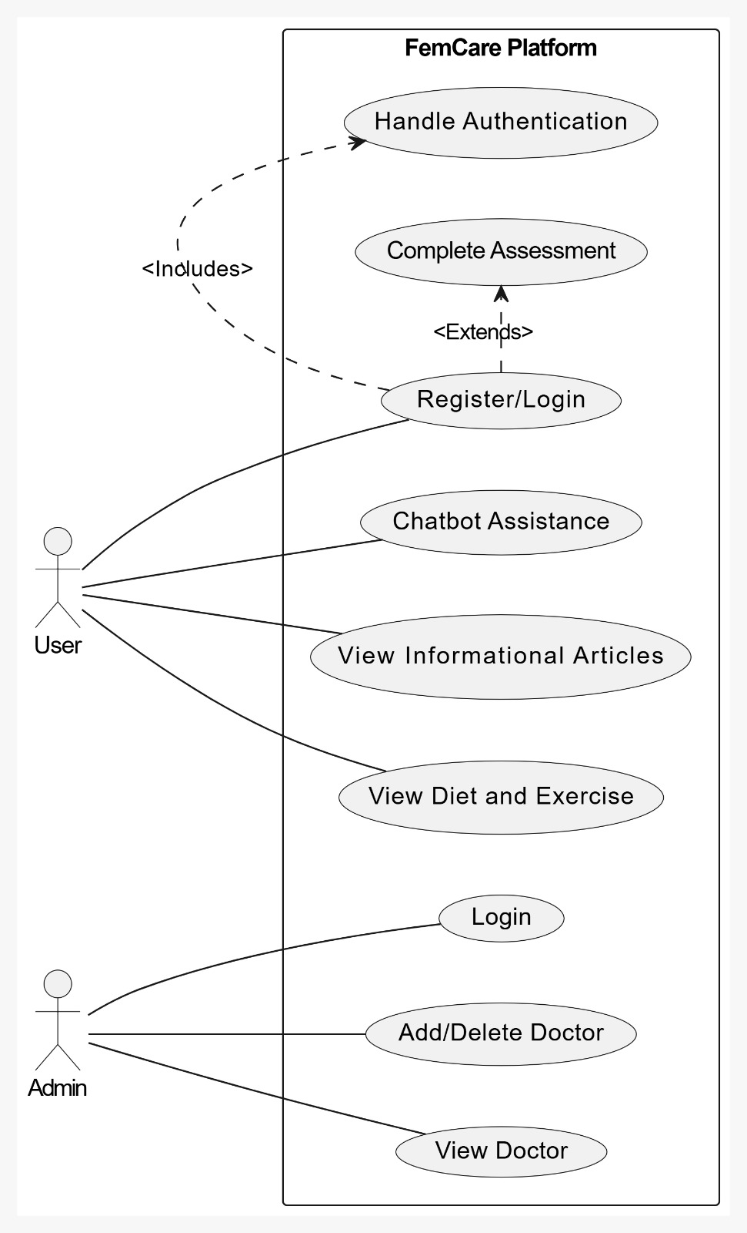
Use Case Diagram

Slide 10
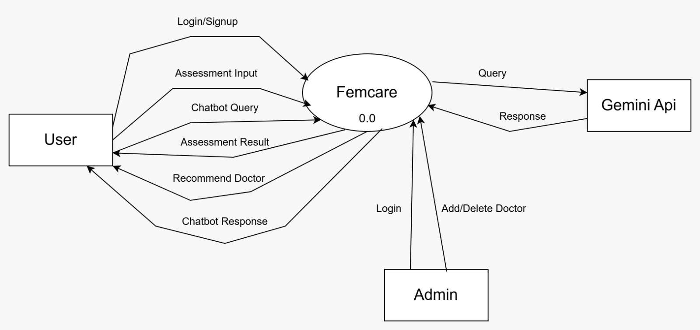
DFD Level 0

Slide 11
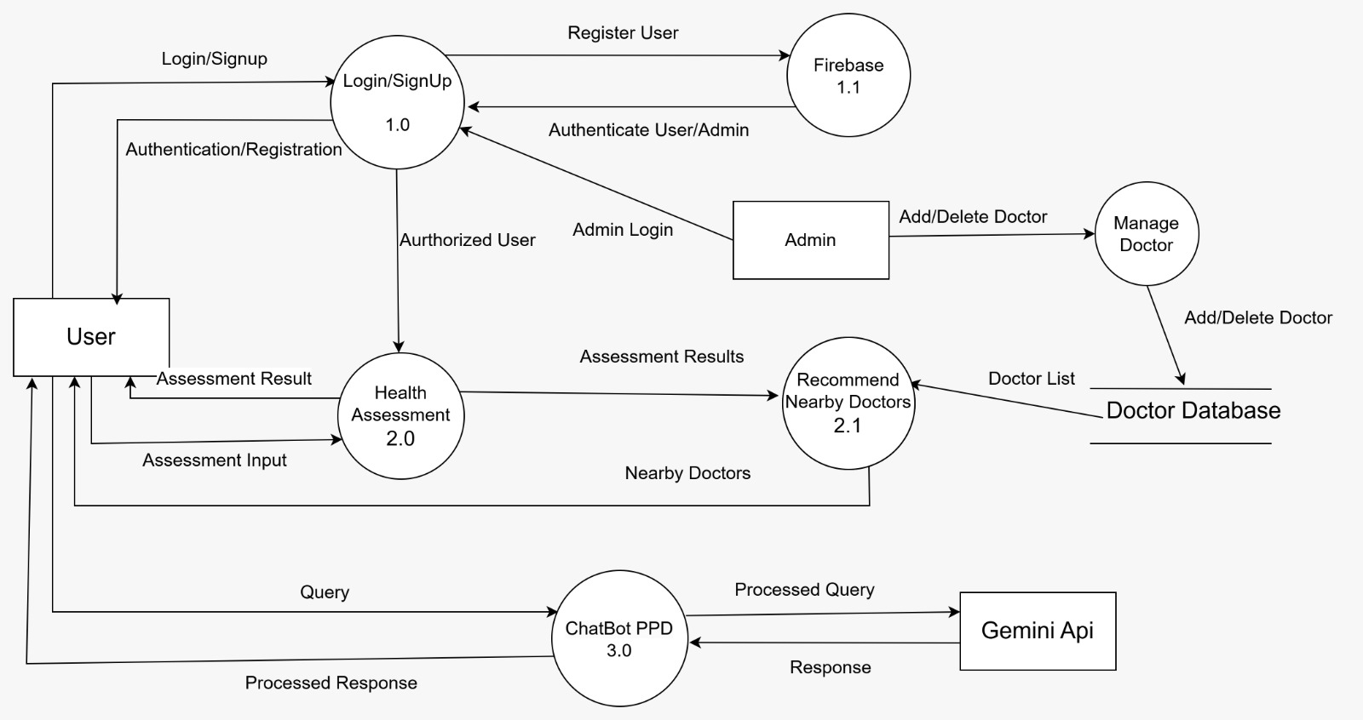
DFD Level 1

Slide 12
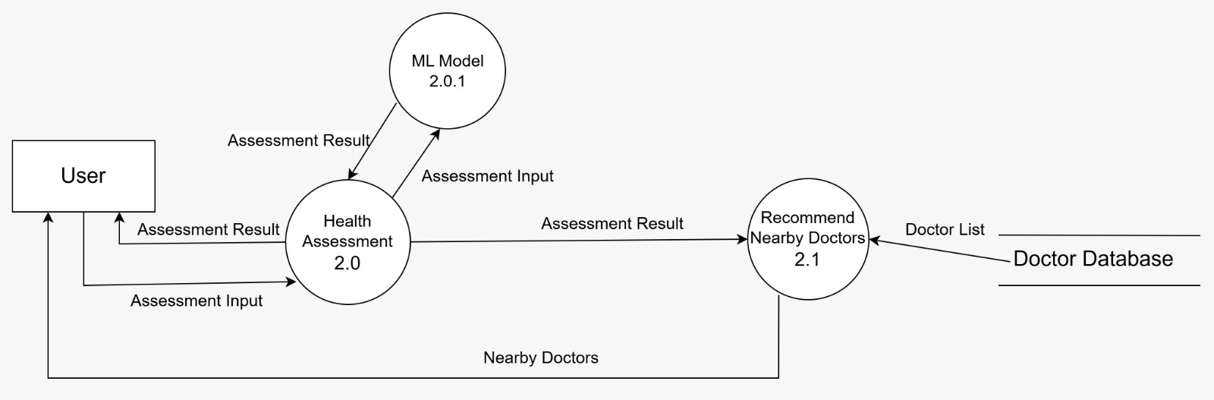
DFD Level 2

Slide 13
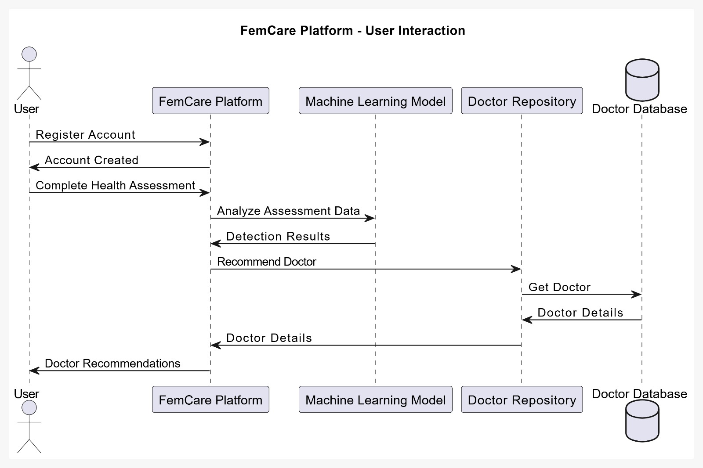
Sequence Diagram- User Interaction

Slide 14
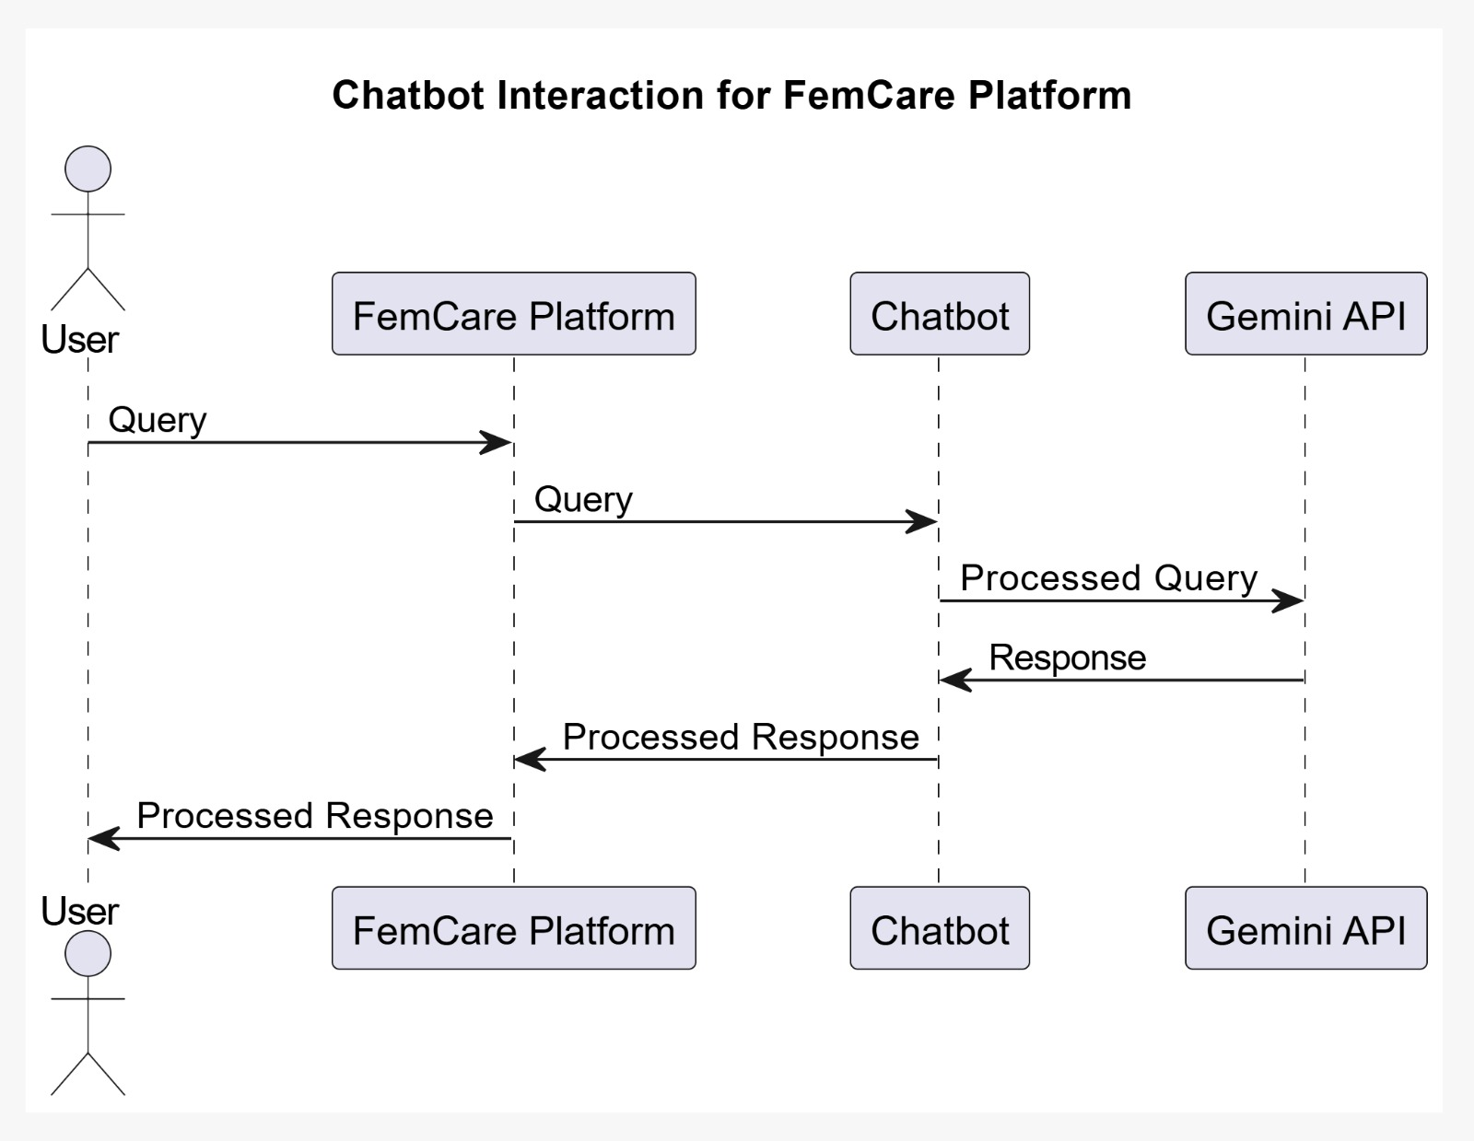
Sequence Diagram- ChatBot Interaction

Slide 15
Evaluation Metrics:
Accuracy: This metric measures the proportion of correctly classified instances out of the total number of instances. Accuracy is good when the dataset is balanced (classes are roughly equal in number).
Accuracy= Number of Correct Predictions​/Total Number of Predictions
Accuracy=TP+TN/FP+FN+TP+TN​
Cross-validation: Repeated stratified k-fold cross-validation is performed to estimate the model's performance on unseen data. This is important for imbalanced datasets to ensure fair evaluation.

Slide 16
SOFTWARE AND HARDWARE REQUIREMENTS
Software requirements
Frontend : React
Backend: Python, Flask
Hardware Requirements
CPU: Multi-core processors with at least 4-8 cores.
RAM: 16-32 GB of RAM, depending on the amount of concurrent traffic and the complexity of AI operations.
Storage: SSD storage with at least 500 GB for faster data access and better performance.
Network: A stable internet connection with sufficient bandwidth to handle website traffic.

Slide 17
FUNCTIONAL AND NON FUNCTIONAL REQUIREMENTS
Functional Requirements
User Management: Sign-up and login.
Health Assessment: Tool for early detection of postpartum depression with personalized recommendations.
Machine Learning: Predict risk of postpartum depression.
Professional Recommendations: Suggest doctors and counselors based on assessments.
Chatbot: Assist users with queries, and guidance.
Health Resources: Provide articles, tips, and focused on women's mental health.
Non-Functional Requirements
Performance: Low latency for assessments and chatbot responses.
Usability: Intuitive interface accessible on both desktop and mobile.
Maintainability: Well-documented, modular codebase for easy updates.

Slide 18
Expected Outcomes
Early Detection
Outcome: Identifies early signs of postpartum depression.
Impact: Enables timely intervention, reducing severity.
Access to Specialized Care
Outcome: Tailored recommendations for doctors and counselors.
Impact: Improved quality of care.
Health Education
Outcome: Provides educational content on mental health.
Impact: Informed decision-making and proactive health management.
User Engagement
Outcome: User-friendly interface and responsive chatbot.
Impact: High user satisfaction and engagement.

Slide 19

Results
Sign Up Page

Slide 20
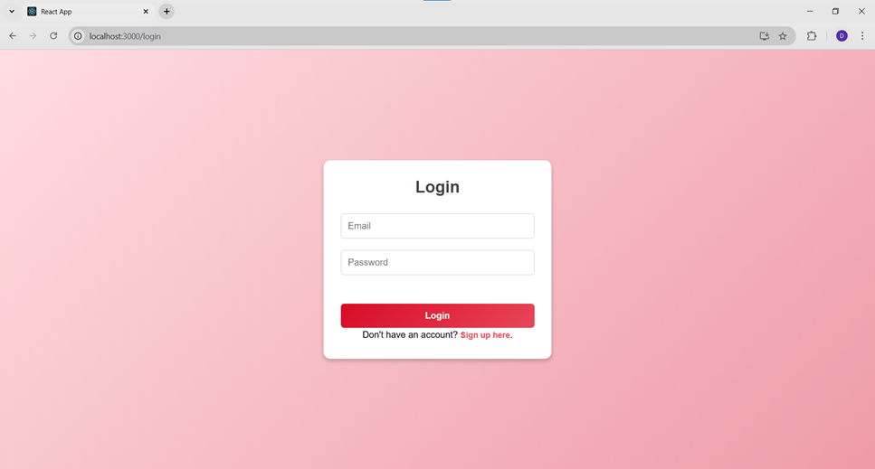
Login Page

Slide 21
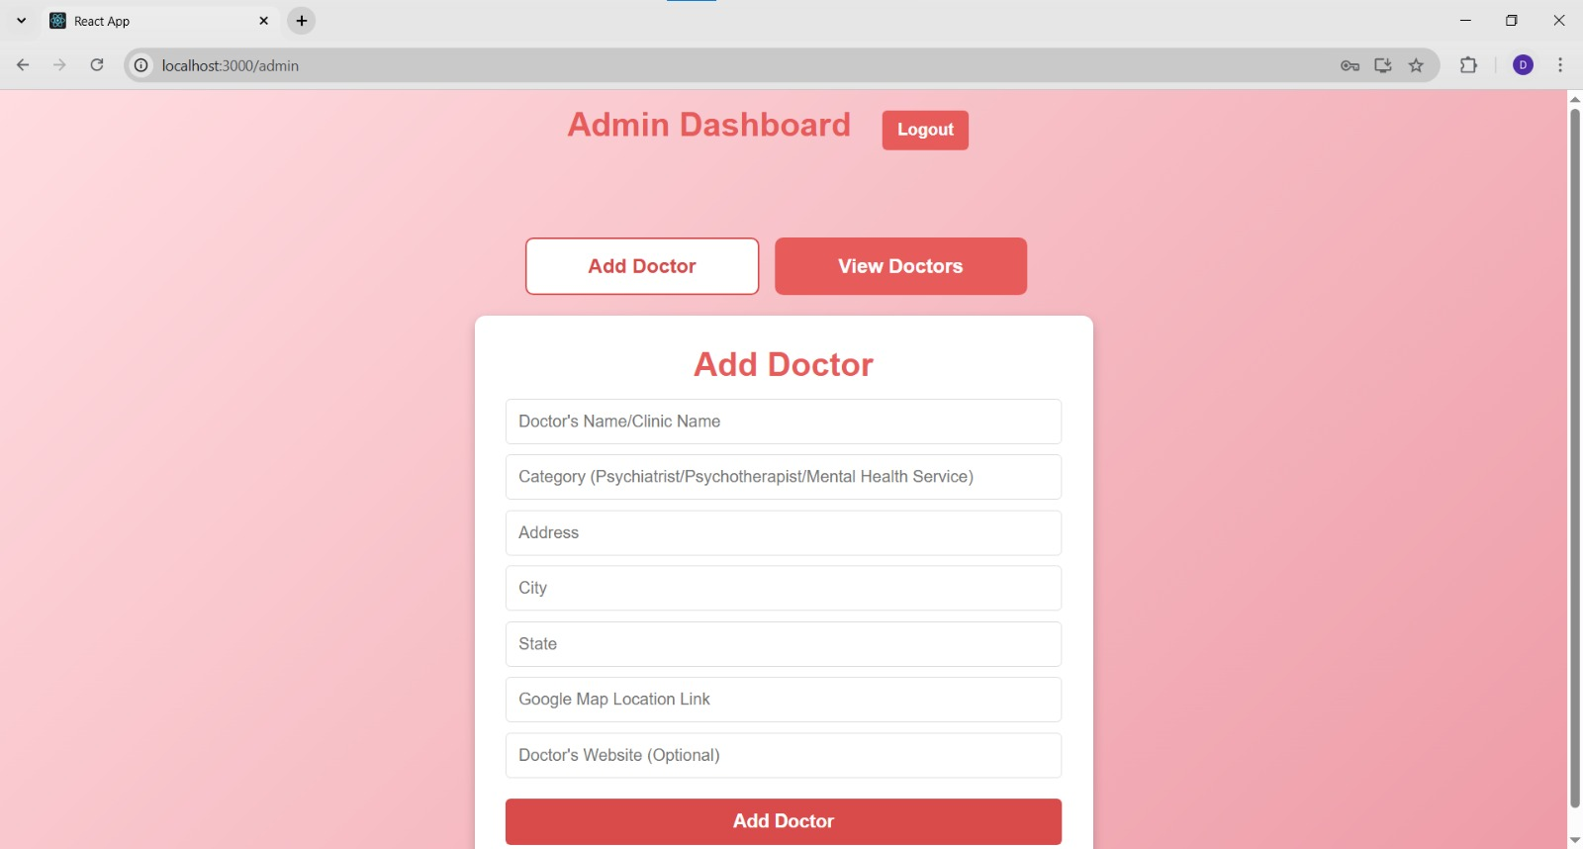
Admin Page
Admin can add doctor’s information

Slide 22
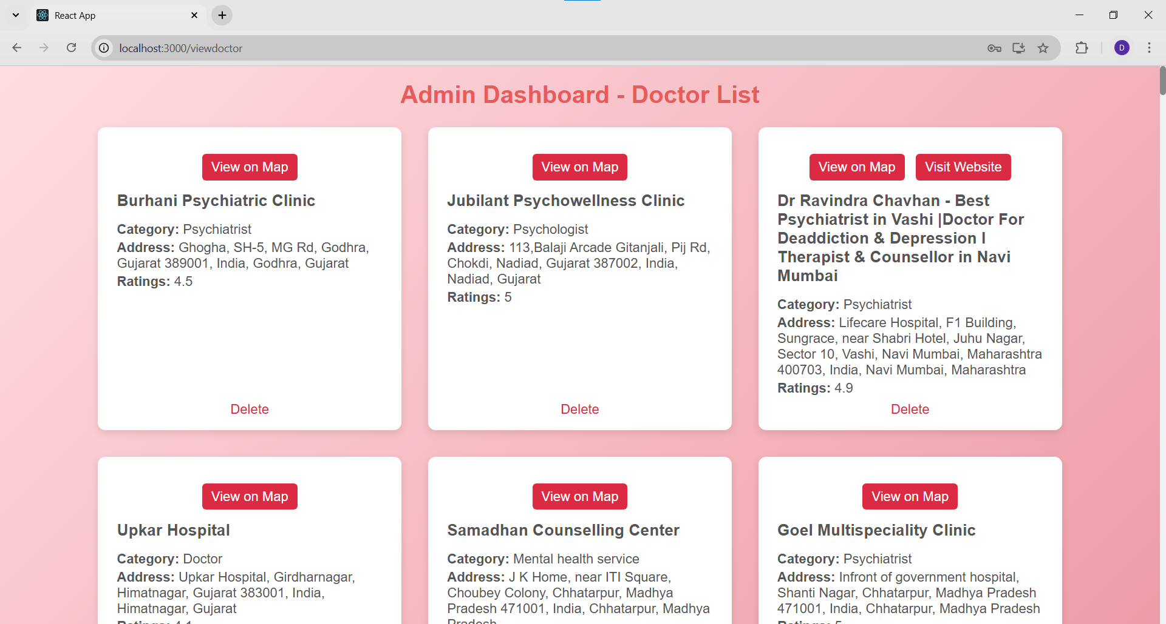
Admin can view list of doctors and can delete them

Slide 23
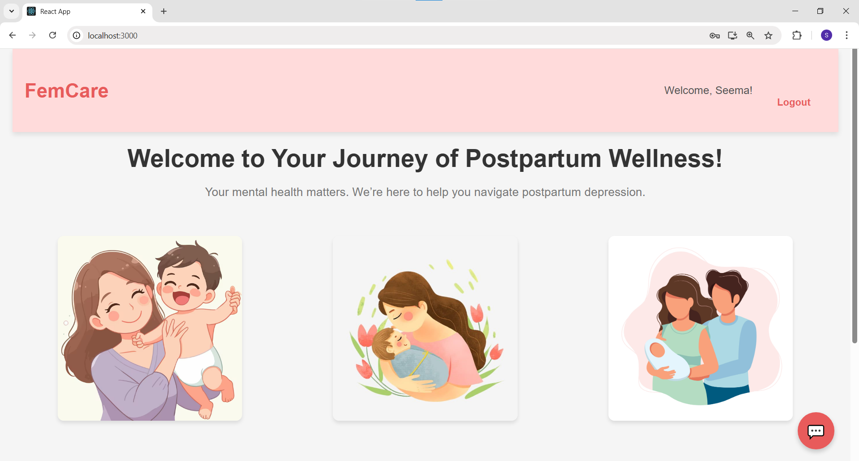
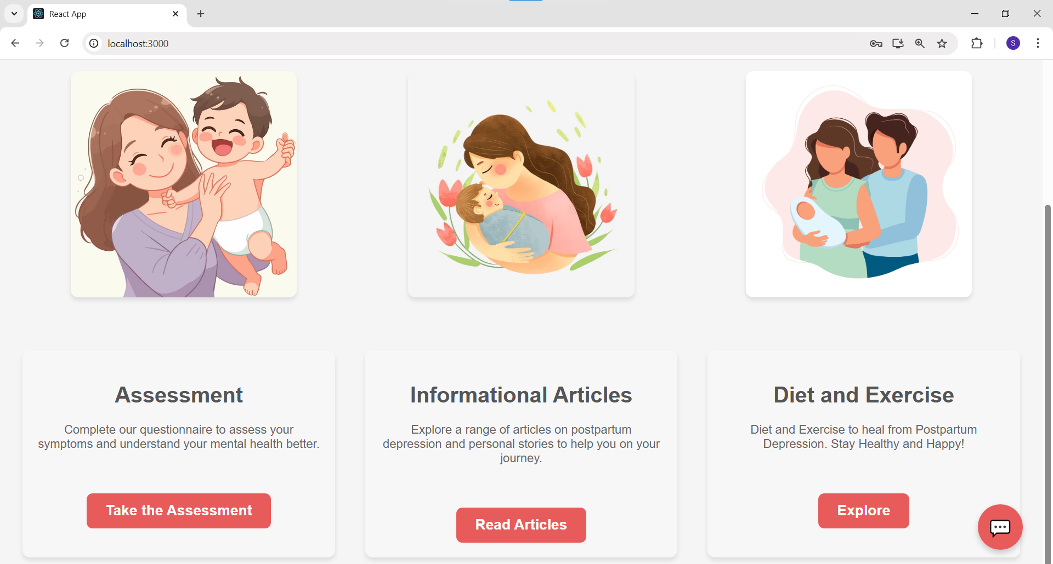
Home Page

Slide 24
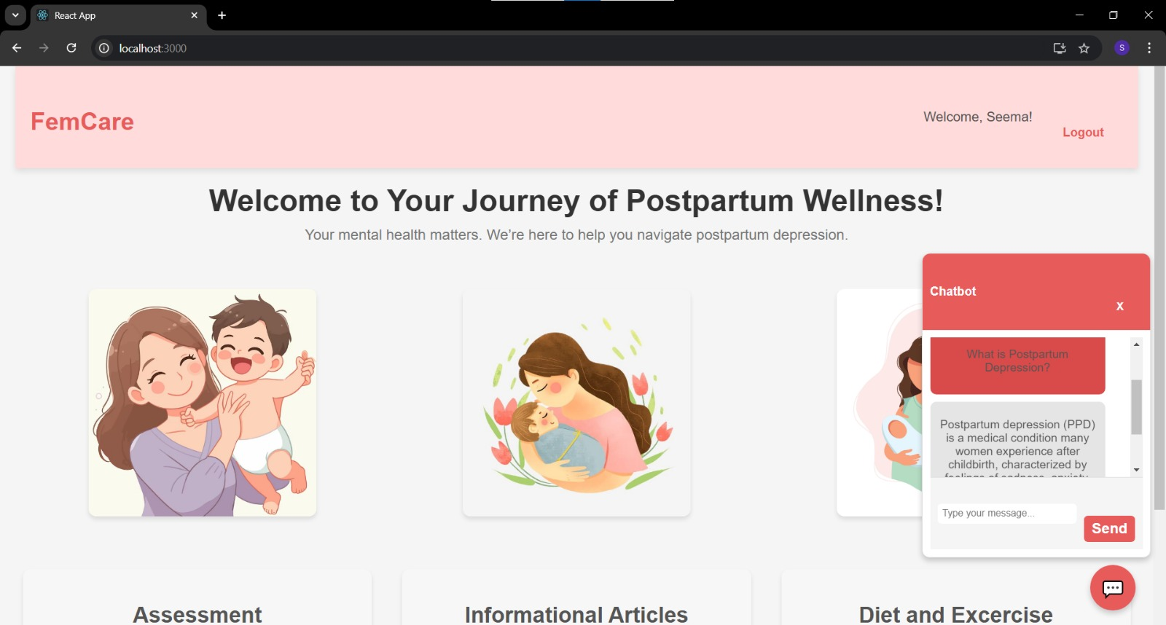
Chatbot

Slide 25
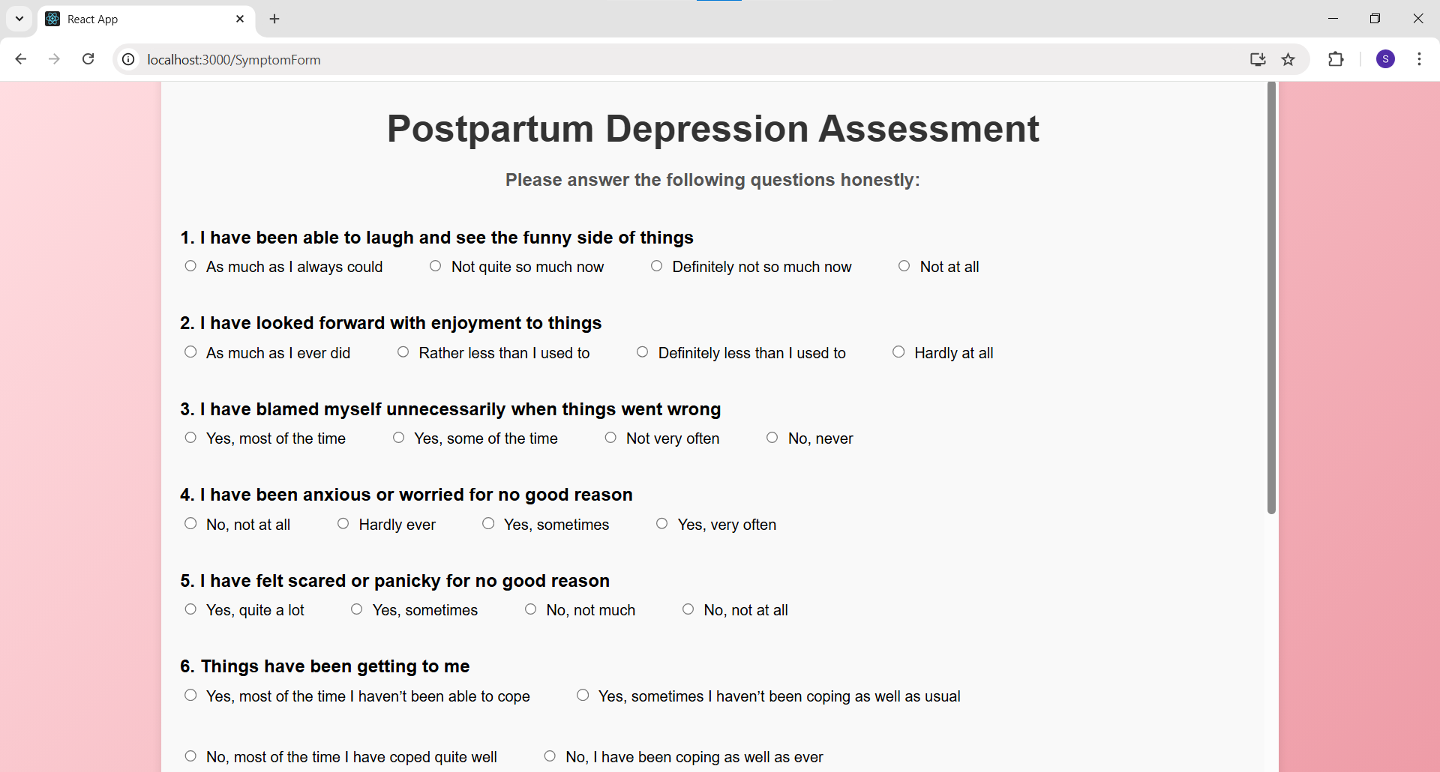
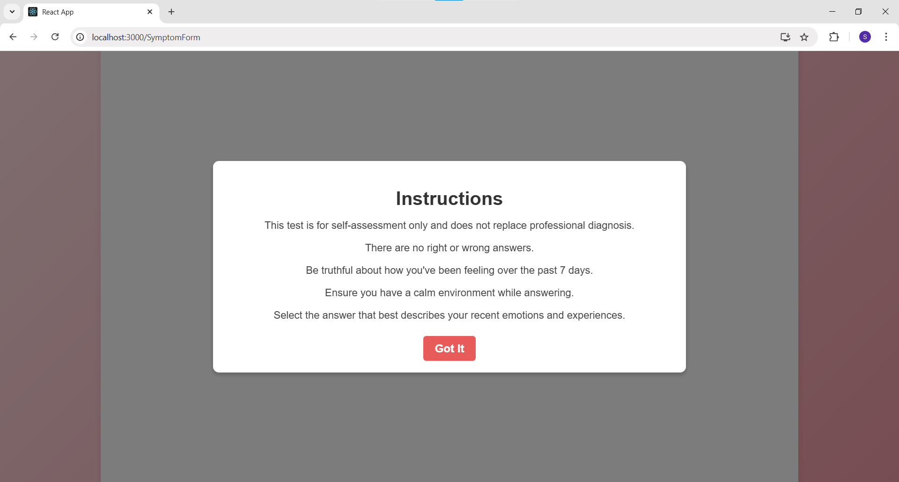
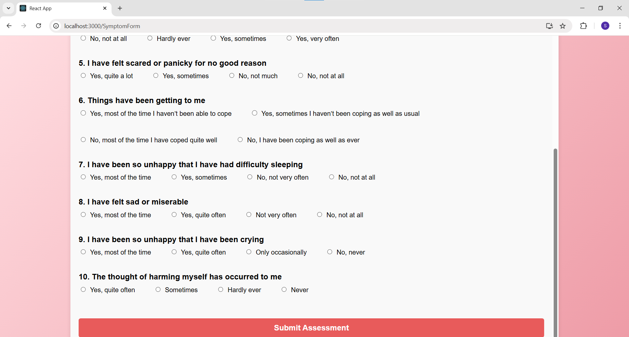
Assessment Section

Slide 26
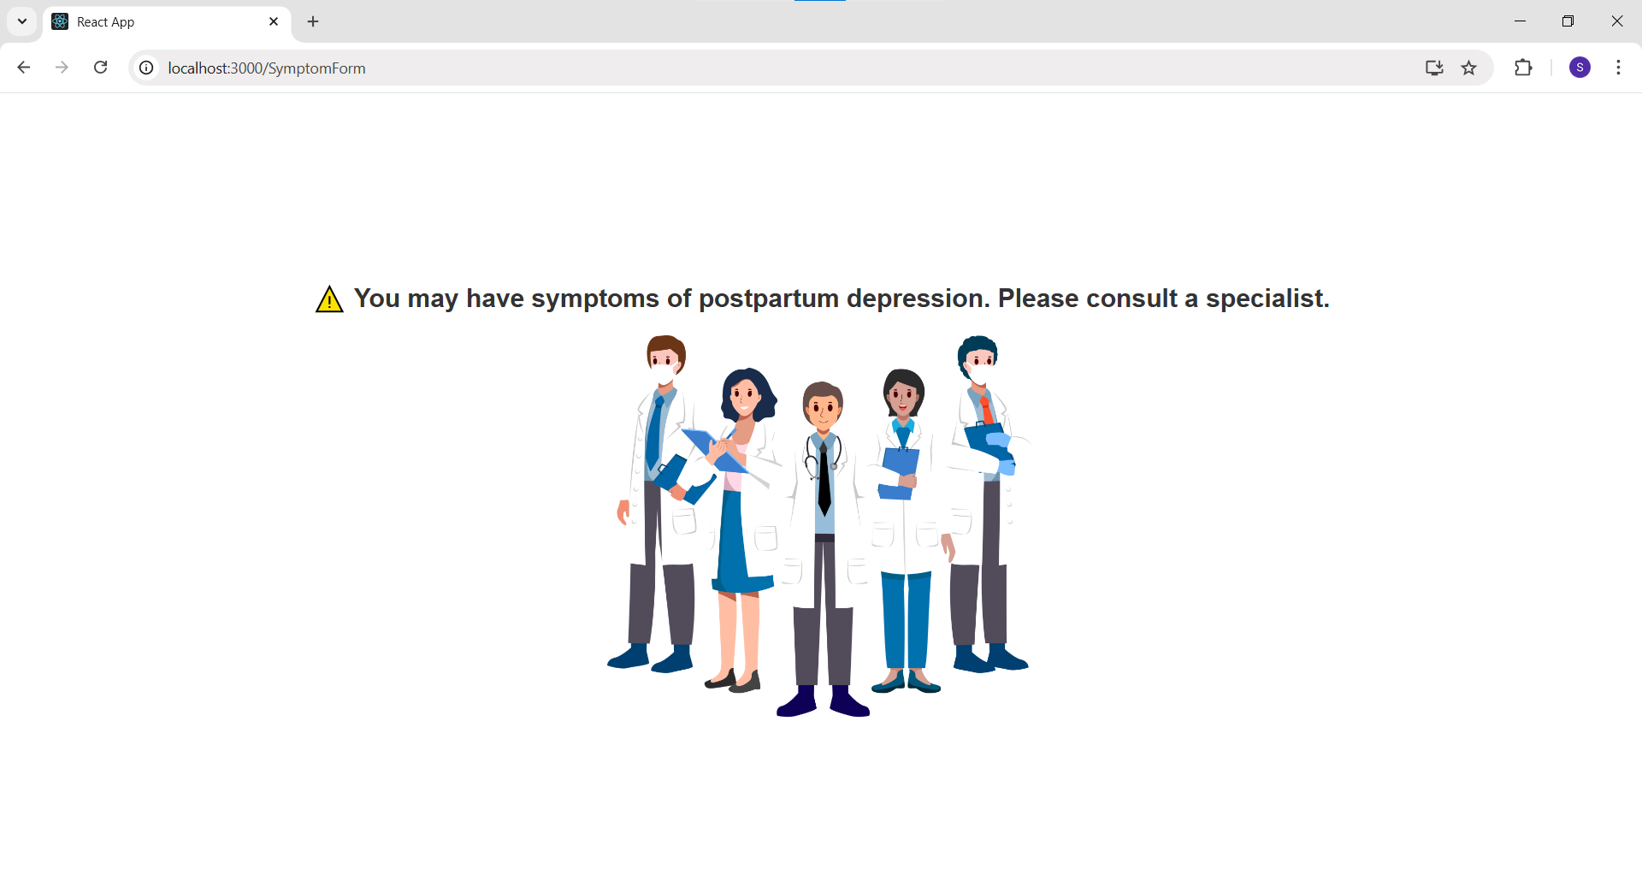
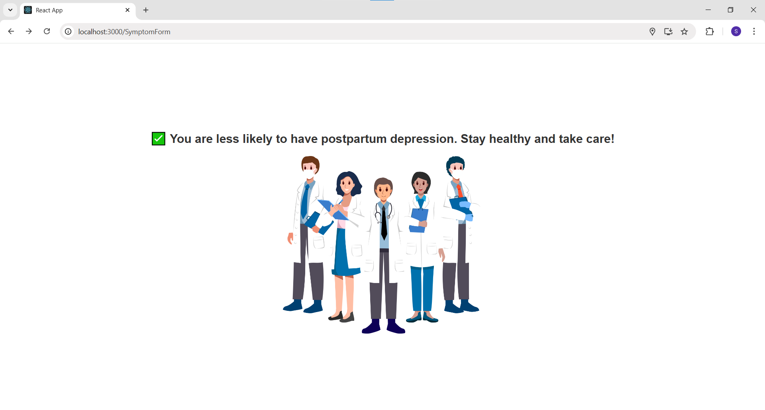
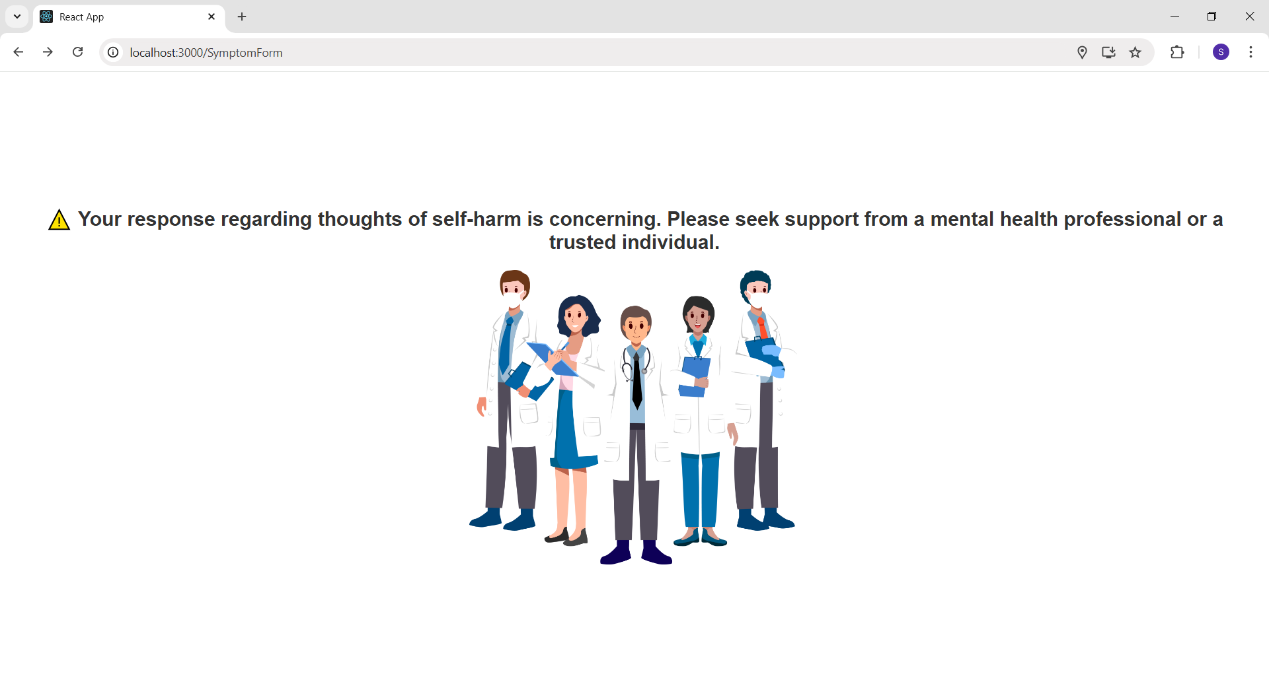
Risk Of PPD
No Risk Of PPD
Self Harming Thoughts
Result of Assessment

Slide 27
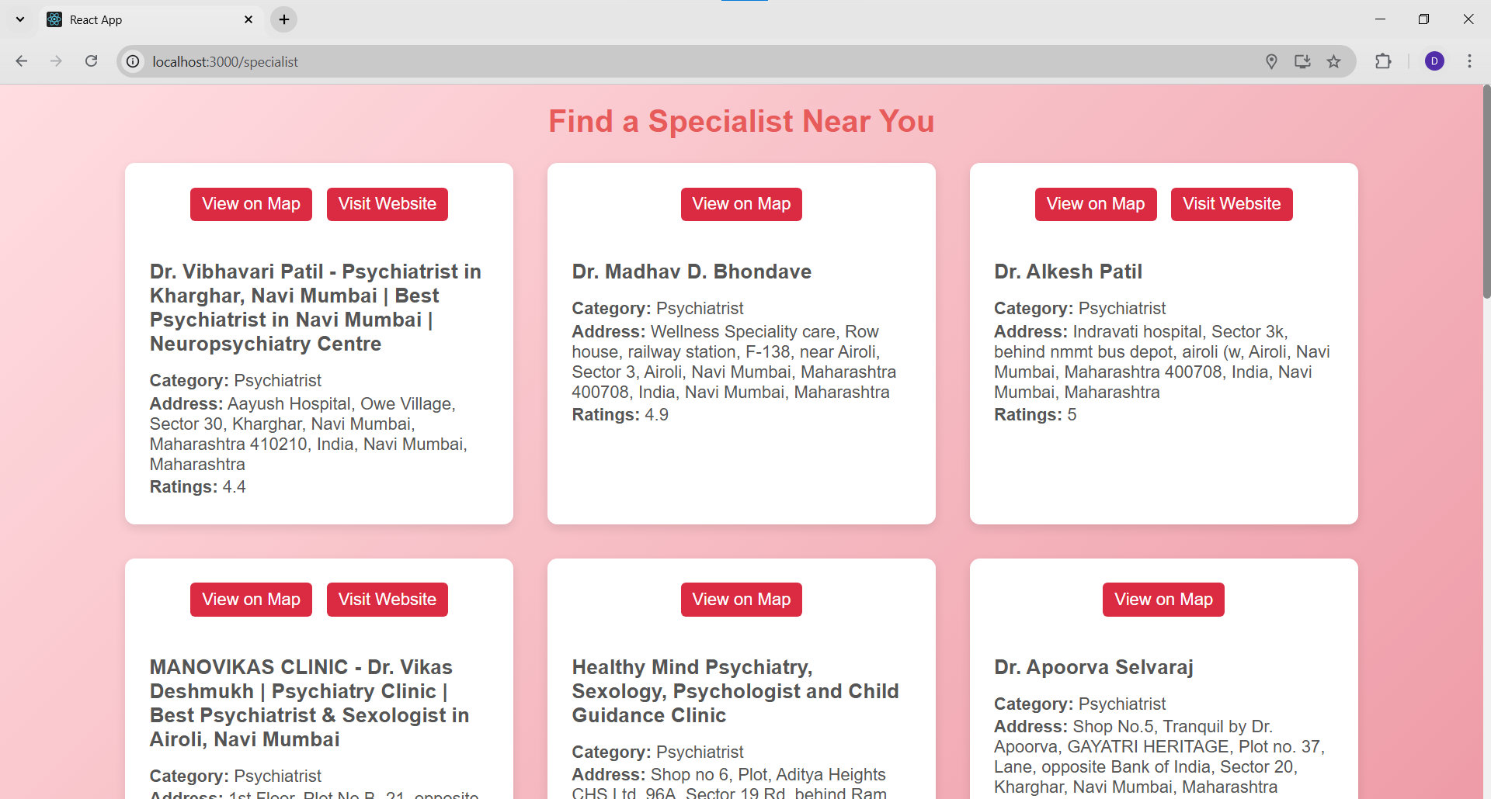
Specialist around User’s Location

Slide 28
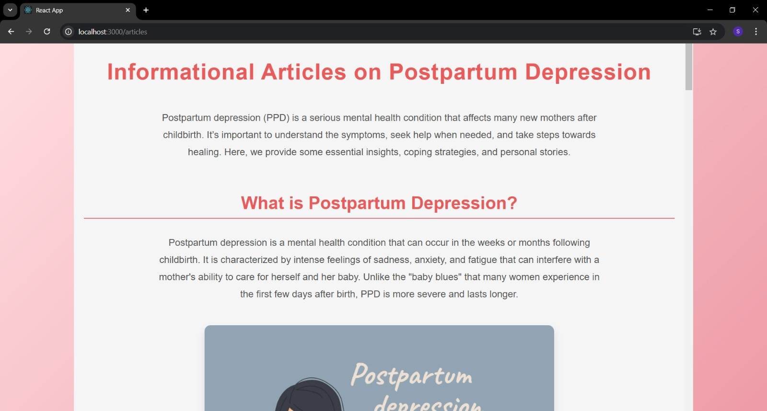

Slide 29
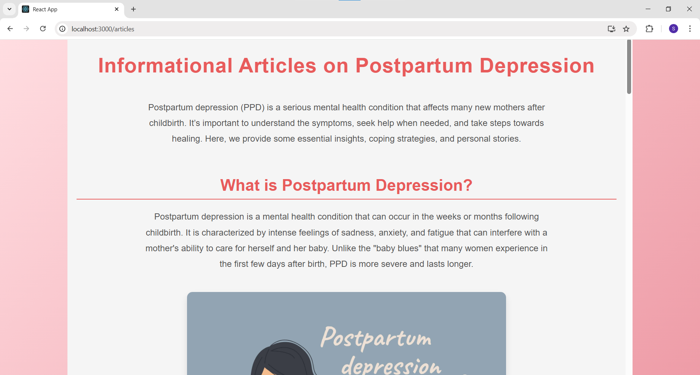
Information Article section

Slide 30
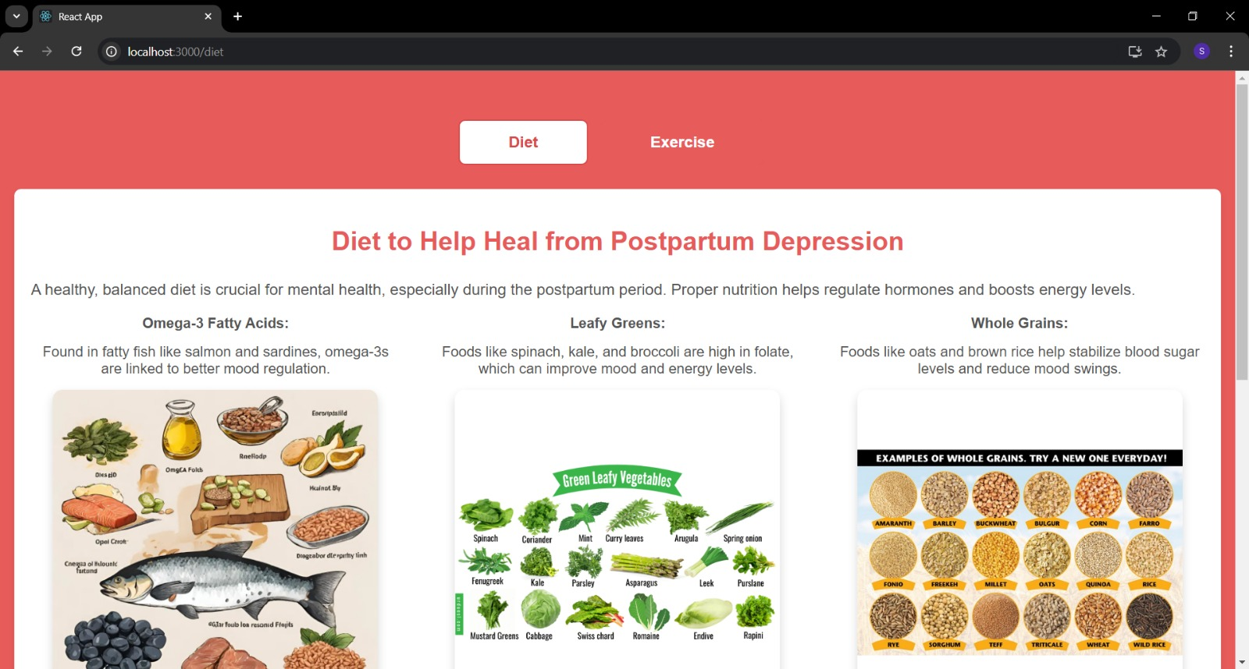
Diet section

Slide 31
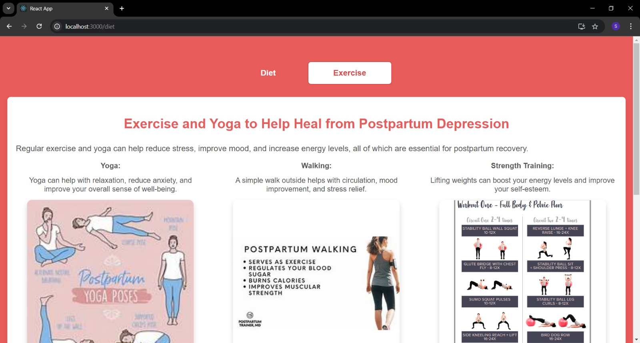
Exercise section

Slide 32
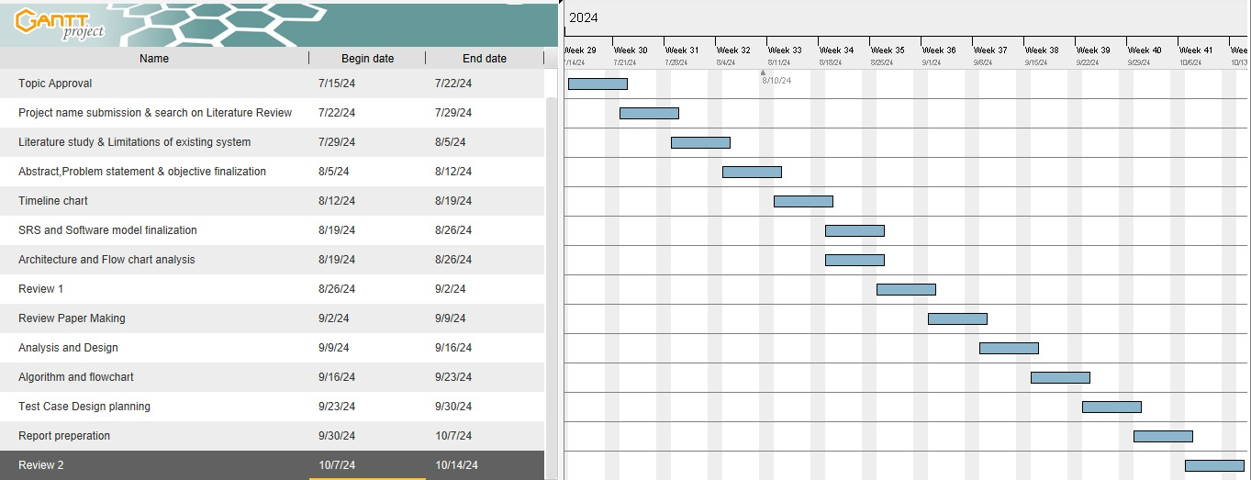
Timeline Chart

Slide 33
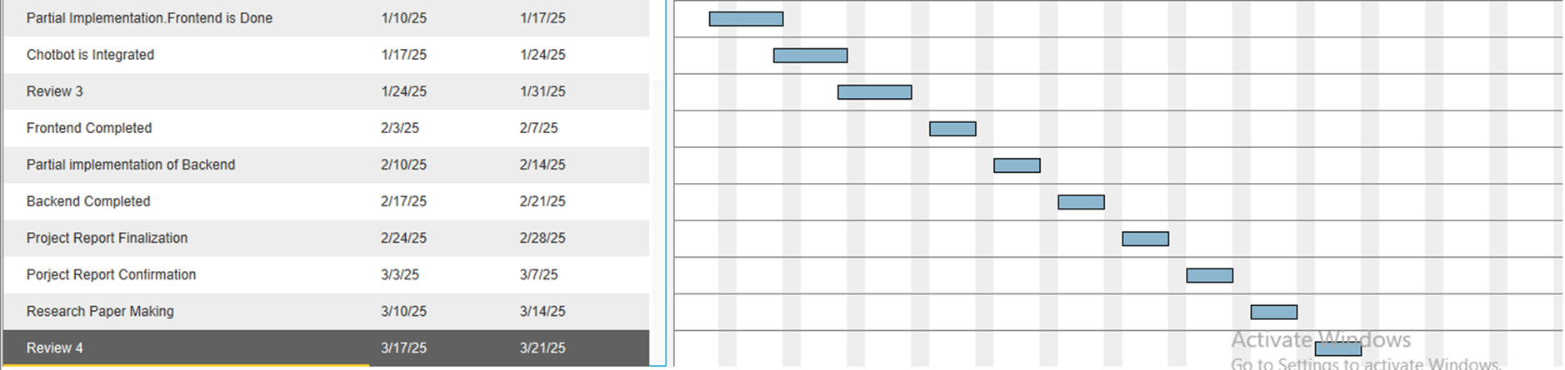
Timeline Chart

Slide 34
Conclusion and Future scope
FemCare is an AI-powered platform supporting women’s mental health, especially for early detection and management of postpartum depression. Using machine learning model, it identifies signs and connects users to specialists. Its intuitive interface, educational resources, and interactive chatbot provide a supportive experience.
Future plans include expanding datasets for better inclusivity, integrating wearable data, enhancing chatbot empathy with NLP, and adding features like multilingual support, offline access, and video consultations to broaden its reach.

Slide 35
References
1) Levis, B. Accuracy of the Edinburgh Postnatal Depression Scale (EPDS) for screening to detect major depression among pregnant and postpartum women: systematic review and meta-analysis of individual participant data. BMJ. 2020;371.
2) Sidebottom A, Vacquier M, LaRusso E, Erickson D, Hardeman R. Perinatal depression screening practices in a large health system: identifying current state and assessing opportunities to provide more equitable care. Arch Womens Ment Health. 2021;24(1):133–44.
3) Abajobir AA, Maravilla JC, Alati R, Najman JM (2016) A systematic review and meta-analysis of the association between unintended pregnancy and perinatal depression. J Affect Disord 192:56–63.
4) Ahmed A, Feng C, Bowen A, Muhajarine N (2018) Latent trajectory groups of perinatal depressive and anxiety symptoms from pregnancy to early postpartum and their antenatal risk factors. Arch Womens Ment Health 21(6):689–698.
5) Dennis, C. L., Falah-Hassani, K., & Shiri, R. (2017). Prevalence of antenatal and postnatal anxiety: Systematic review and meta-analysis. British Journal of Psychiatry, 210, 315–323.
6) Danaher, B. G., Milgrom, J., Seeley, J. R., Stuart, S., Schembri, C., Tyler, M. S., Ericksen, J., Lester, W., Gemmill, A. W., & Lewinsohn, P. (2012). Web-based intervention for postpartum depression: Formative research and design of the MomMoodBooster Program. JMIR Research Protocols, 1(2), e18.
7) Nielsen, D.; Videbech, P.; Hedegaard, M.; Dalby, J.; Secher, N. Postpartum depression: Identification of women at risk. BJOG Int. J.Obstet. Gynaecol. 2000, 107, 1210–1217.

Slide 36
THANK YOU

